Slide 1



Implementation of MobileNet V3 in
Classifying Butterfly Species
with Android & Cloud‑Based App Development

Slide 2
















TABLE OF CONTENTS
Research Methodology
GCP Web Services Implementation
Research Objective
The methodology follows seven structured steps, including data collection, preprocessing, model training, evaluation, deployment via Google Cloud services, and mobile application development for real-world usage.
The research aims to develop an Android app that classifies six butterfly species using MobileNetV3-Large and Google Cloud, enabling efficient, real-time recognition and species learning on mobile devices.
The backend uses Google Cloud's Virtual Machine for handling user APIs and Cloud Run for hosting the trained model, ensuring low-latency and scalable butterfly species classification.
Background
Sample Selection
Experiments and Analysis
Conclusion
Butterflies are vital to ecosystems but face population decline due to human impact. This study addresses the lack of mobile-friendly tools for species identification and conservation education.
Six butterfly species were selected to ensure dataset diversity. These samples represent varying wing patterns and colors, allowing the model to learn a broad range of visual features.
The study successfully integrates deep learning with mobile and cloud technologies to classify butterfly species. The system is effective, resource-efficient, and beneficial for conservation and education.
Model training was conducted using two data splits (70:30 and 80:20). Results showed 94% accuracy with the 80:20 split, highlighting better generalization and fewer classification errors.

Slide 3

Background & Motivation
•Butterflies are key pollinators and bio‑indicators, yet many species are declining.
•Indonesia hosts ≈2 000 species, but urbanization and deforestation threaten diversity.
•Lack of mobile‑friendly identification tools hampers conservation and education efforts.

Slide 4
Research Objective
•Develop an Android app that accurately classifies six butterfly species.
•Employ MobileNetV3‑Large (lightweight CNN) through Transfer Learning.
•Leverage Google Cloud Platform (Cloud Run) to offload computation.
•Include an on‑device encyclopedia and real‑time camera scanning.

Slide 5

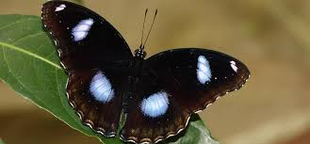
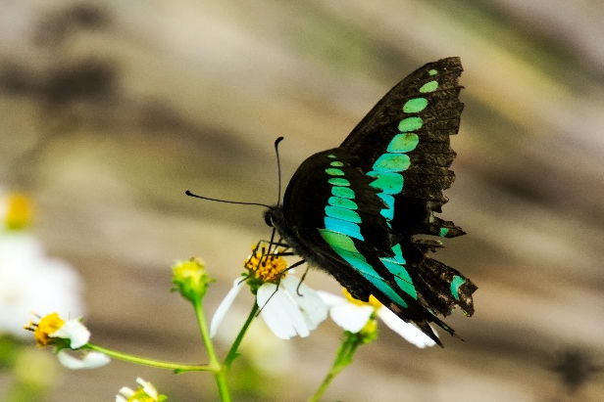
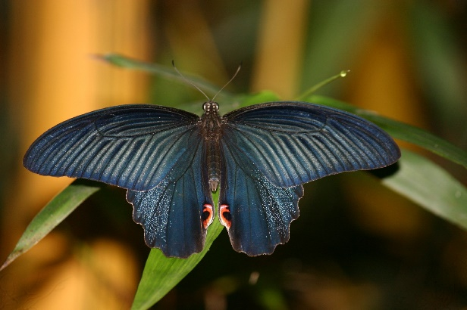
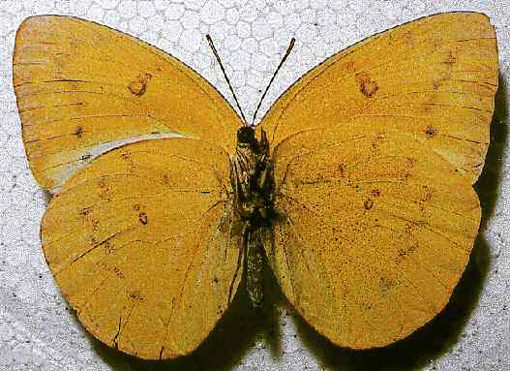
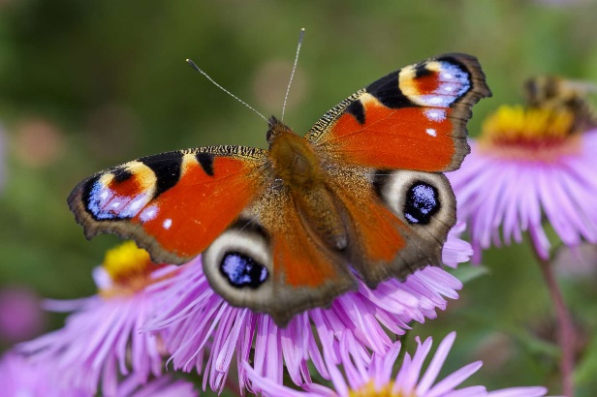
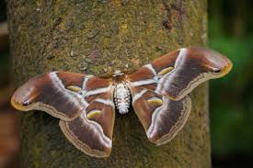
Dataset Overview
•110 original images (50 field, 60 literature).
•Random augmentation → 6000 images (1000 per class)
Shortlisted 6 Classes for Classifying Butterfly Species
Boolina eggfly
Papilio memnon
Graphium Sarpedon
Catopsilia Scylla
Peacock
Samia Ricini

Slide 6

1
Data Collection
2
Preprocessing & Augmentation
3
Train/Test Split (70:30 & 80:20)
Research Workflow
Model Construction (MobileNetV3‑Large)
4
5
Evaluation
(Accuracy, Precision, Recall, F1)
6
GCP Web Services
(VM + Cloud Run)
7
Android App Development

Slide 7
CNN Model & Hyperparameters
• Base model: MobileNetV3‑Large
(feature extractor) + FC layers
• Loss: Sparse Categorical Cross‑Entropy
• Metric: Accuracy.
Epochs: 40 •
Batch: 32 •
Optimizer: Adam Learning rate: 1 ×10⁻⁴ •

Slide 8
Experimental Setup
Laptop: Intel i5‑8520U •
12 GB RAM •
NVIDIA MX150 •
Win 11 Pro. •
Smartphone: Samsung Galaxy A32 •
Android 13 •
• 64 MP camera.
•Software: Python 3.12
• TensorFlow
• Android Studio
• Docker
• GCP.

Slide 9
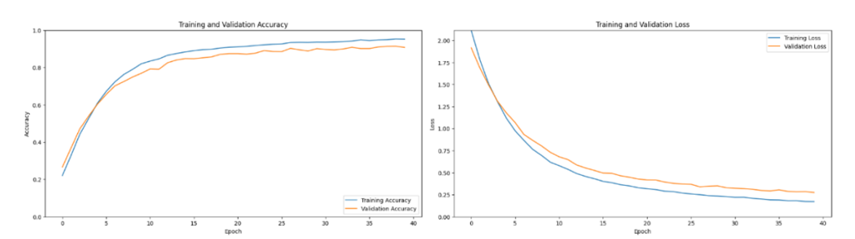
Results – 70:30 Split
•Validation Accuracy: 90 %.
•Precision/Recall/F1 per class: 0.85 – 0.96.
•Misclassifications mainly for Graphium Sarpedon.

Slide 10
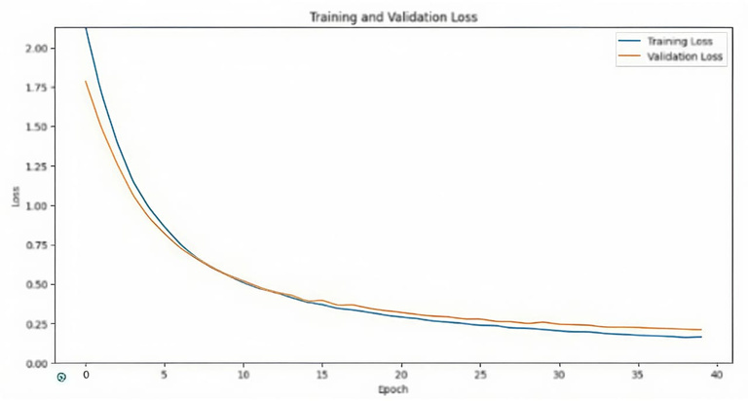
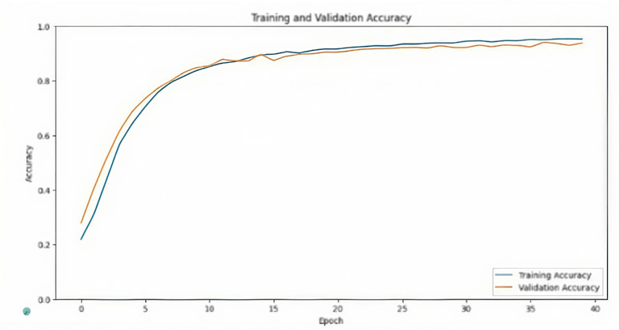
Results – 80:20 Split (Selected)
•Validation Accuracy: 94 %.
•Precision/Recall/F1 ≥ 0.89 for every class.
•Better stability and lower loss; chosen for deployment.

Slide 11
Training Curves
•Fast accuracy rise in the first 15 epochs, then plateaus.
•80:20 split shows consistently lower validation loss.
•Indicates improved generalization with a larger training set.

Slide 12
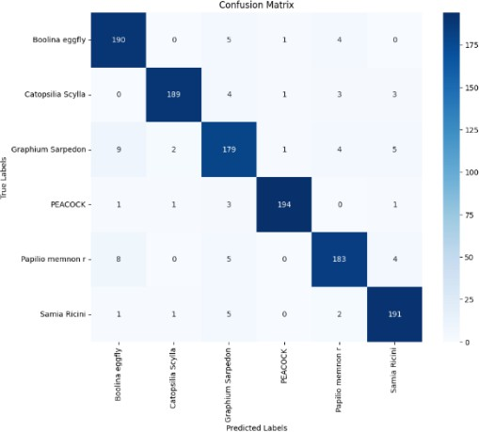
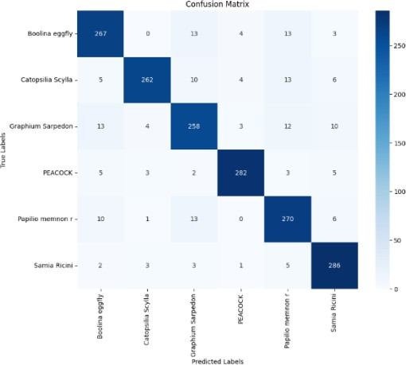
Confusion Matrix
Insights
70:30: Graphium Sarpedon ↔ Boolina eggfly/Papilio
memnon confusion
80:20: Fewer off‑diagonal errors; cleaner predictions.
Diagonal dominance confirms:
high class‑specific accuracy

Slide 13
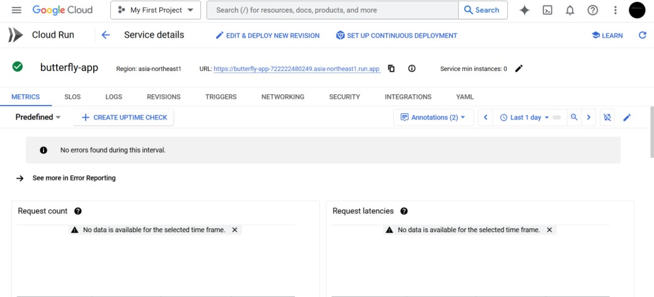
Deployment on
Google Cloud
Platform
•Virtual Machine: Node.js backend (Login, Register, Library APIs).
•Cloud Run: Containerized Flask service hosting butterfly.keras model.
•External endpoints enable a lightweight Android client.

Slide 14
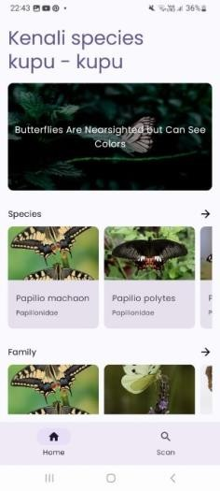
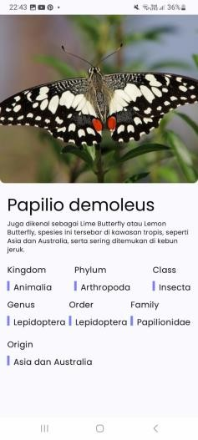
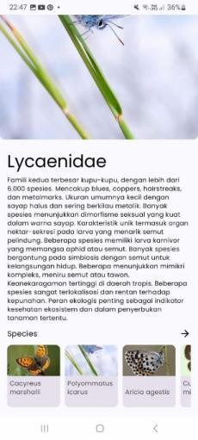
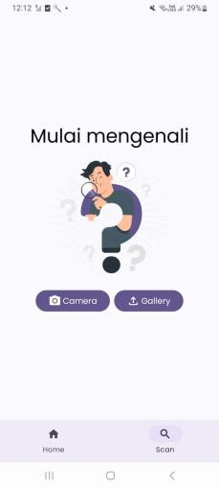
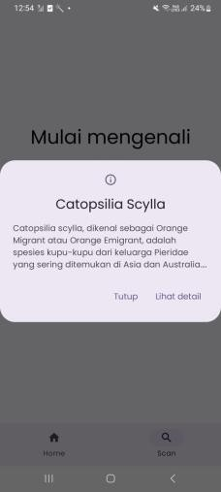
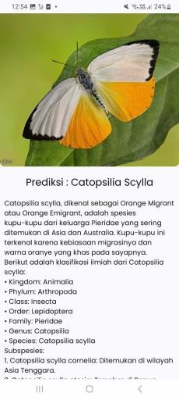
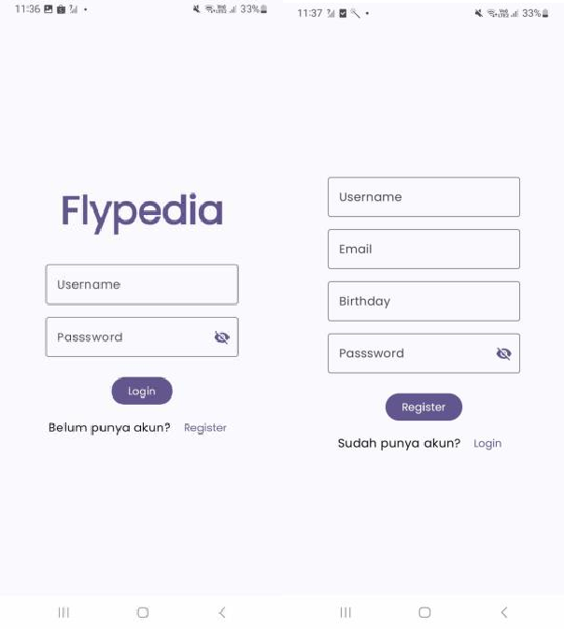
Android App Features
Secure login/
Registration
with GCP
VM API
Home
Authentication
Scan
Encyclopedia of butterfly families & species.
Camera or gallery image → cloud inference → species name & details.

Slide 15
Conclusion
✅ Implemented using MobileNet V3 Large architecture
🎯 Achieved 0.94 accuracy with an 80:20 train-test split
📊 Precision, Recall, and F1-score all exceeded 0.90
🦋 Classified six butterfly species effectively
☁️ Integrated Google Cloud Platform (GCP) to overcome mobile resource limitations
📱 Cloud handles ML model while Android app ensures smooth user experience
📚 Included butterfly library and scanning feature for easy interaction
👧 Received positive feedback from primary school students
💡 Proved the effectiveness of combining CNN and cloud computing
⚖️ Balanced accuracy, performance, and user engagement

Slide 16
Thank You

